Slide 1

BACHELOR OF TECHNOLOGY
IN
Artificial Intelligence and Machine Learning
Application Development –Deep Learning Explore ( MR22-1CS0203)
Section: Beta
Batch Number: BT6
Project Title: HUMAN EMOTION DETECTION
Project Guide: Prof.Ramya
 | Roll Numbers
 | 2211CS020118
 | 2211CS020119
 | 2211CS020120
 | 2211CS020122
 | 2211CS020123
Department of AIML, School of Engineering
Malla Reddy University

Slide 2
ABSTRACT:
Human emotion detection is a critical area of research with applications spanning mental health, customer service, and human-computer interaction. This project explores an advanced system for detecting and analyzing human emotions using a combination of facial expression recognition, voice analysis, and physiological signal processing. By integrating machine learning algorithms with real-time data acquisition methods, the proposed system aims to achieve high accuracy and reliability in emotion recognition.
The project involves the development of a robust data pipeline, from data collection and preprocessing to model training and evaluation. We utilize publicly available emotion-labeled datasets, as well as custom data gathered through user studies, to train and validate our models. Performance metrics such as accuracy, precision, and recall are employed to assess the effectiveness of the system. This project contributes to the growing field of affective computing by providing a comprehensive solution for emotion detection that integrates multiple data sources and advanced machine learning techniques. The outcomes have the potential to benefit various industries by enabling more empathetic and responsive interactions between humans and technology.

Slide 3
LITERATURE:
Emotion detection is key in customer service, mental health, and human-computer interaction. Using facial expression analysis, vocal tone recognition, and machine learning, these technologies improve decision-making and user experiences.
Advanced Methods:
Advanced Techniques: Improved algorithms for facial and contextual emotion recognition.
Neural Networks: CNNs and RNNs boost accuracy in complex emotional patterns.
Multimodal Integration: Combines facial and vocal data for more precise detection
Approaches:
Recognition Algorithms: Advanced algorithms for accurate detection in diverse contexts.
Multimodal Integration: Combines facial and vocal data with preprocessing for clarity.
Ethical Considerations: Ensures privacy and ethical use.
Challenges & Future Directions:
Data integration, scalability, and improving accuracy through AI. Addressing ethical concerns like privacy and bias.
Conclusion:
Emotion detection is advancing with deep learning and real-time systems. Ongoing research is needed for more accurate, adaptable, and ethical solutions.

Slide 4
PROBLEM STATEMENT:
Develop a real-time emotion detection system that integrates facial expressions, and body language to accurately and holistically identify human emotions. This system aims to enhance user experiences across various applications
Facial Expressions: Use advanced computer vision to analyze facial expressions, handling variations in lighting, occlusions, and diverse facial structures.
Body Language: Implement motion tracking and pose estimation to evaluate body language, ensuring accurate detection of gestures and movements.
Real-Time Processing: Fuse data from all modalities for immediate feedback, optimizing for low latency and efficiency.
Personalization & Adaptation: Customize detection algorithms based on userspecific and cultural factors, incorporating user feedback for continuous improvement.
Ethical Considerations: Prioritize privacy, obtain user consent, and mitigate biases in emotion detection.
This system aims to revolutionize customer service, mental health support, education, and entertainment by providing precise, culturally sensitive emotional insights while maintaining high standards of privacy and accuracy.

Slide 5
DATA COLLECTION AND EXPLORATION:
It collects from Kaggle’s Emotions Dataset (.csv) which contains 393,822 unique values on human emotions which can be used to train models, sourced from the internet and surveys. It includes data preprocessing techniques like-
Data Cleaning
Noise Reduction: Remove background noise (audio) and subtract background (video) to enhance clarity.
Outlier Removal: Filter outliers in facial/body language data.
Error Correction: Fix mislabelled/incomplete data.
Image Preprocessing
Face Alignment: Use landmark detection to correct facial orientation.
Face Cropping: Focus on facial features by extracting the face region.
Normalization
Lighting Normalization: Adjust lighting and contrast.
Feature Scaling: Normalize feature values for improved model training
Data Splitting
Split the data into training, validation, and test sets.

Slide 6
MODEL SELECTION:
Convolutional Neural Networks (CNNs): CNNs are effective for image classification tasks, extracting features from facial images to recognize emotions. Common architectures include VGGNet, ResNet, and Inception.
Transfer Learning: Utilize pre-trained CNN models like VGG16 and ResNet50 are fine-tuned on emotion datasets to leverage existing feature extraction, improving accuracy with smaller datasets.
Support Vector Machines (SVMs): SVMs use extracted features like HOG from facial images to classify emotions by finding the optimal hyperplane separating emotion classes.
Ensemble Methods: Combining predictions from models trained on different modalities (e.g., CNNs for facial expressions, RNNs for vocal tone) enhances overall emotion detection accuracy.
Multi-Modal Neural Networks: These models integrate features from multiple sources (e.g., facial expressions, vocal tone, body language) to provide comprehensive emotional insights. Examples include multi-stream CNNs and attention-based models.
Attention Mechanisms: Attention layers prioritize important features across modalities, helping the model focus on relevant data for improved emotion detection.
Transformer Models: Originally used in NLP, transformers can be adapted for multi-model emotion detection, handling complex interactions between various data types.

Slide 7
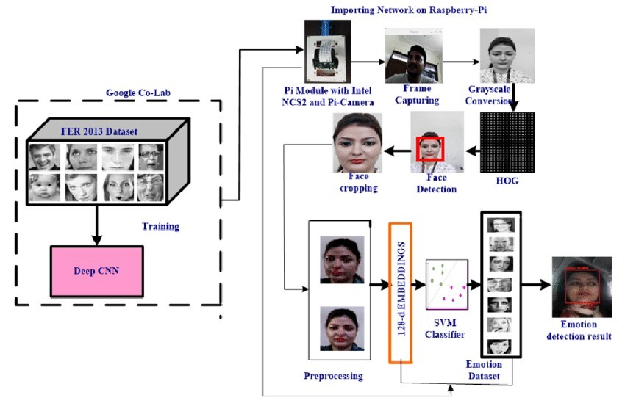
ARCHITECTURE:

Slide 8
DEPLOYMENT & RESULTS:
Model Deployment
To deploy the multimodal emotion detection model, the trained models are saved using frameworks like TensorFlow or PyTorch. A web application (using Flask or Django) provides a user-friendly interface for inputting data, processes it through the respective models, and displays the aggregated emotion results. Docker ensures consistent deployment, and the application is hosted on a cloud service for scalability.
Evaluation Metrics
Model performance is evaluated using accuracy, precision, recall, and F1-score to measure effectiveness across emotions. A confusion matrix helps visualize classification accuracy, and cross-validation ensures the model generalizes well.
Testing Data and Methodologies
The model is tested on a labeled dataset using the Holdout Method (split into training, validation, and test sets) and K-Fold Cross-Validation, providing robustness against overfitting.
Web Application & Integration
The web app includes a loading animation during processing and displays the detected emotions with confidence scores.
Results
Results are presented with images labeled by detected emotion and confidence scores. Visuals include both correct and misclassified examples, highlighting model performance across emotional categories and areas for improvement.

Slide 9
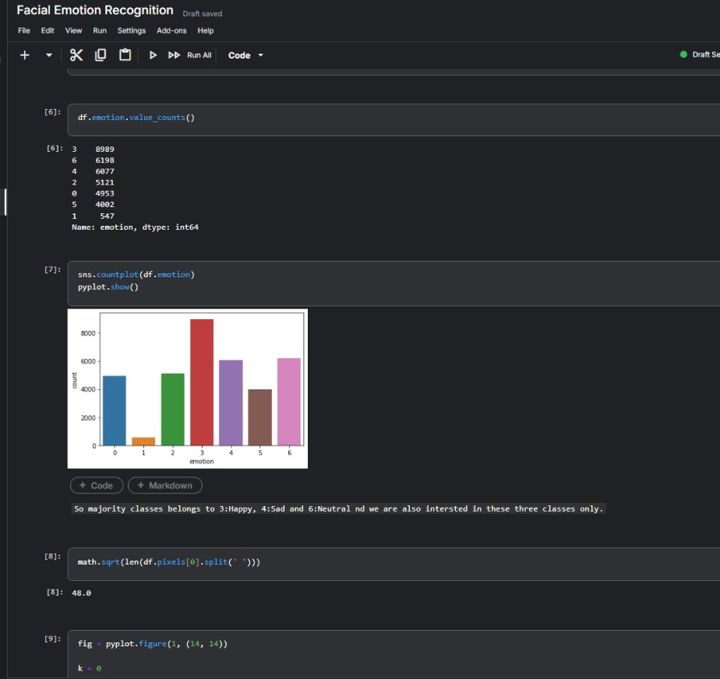
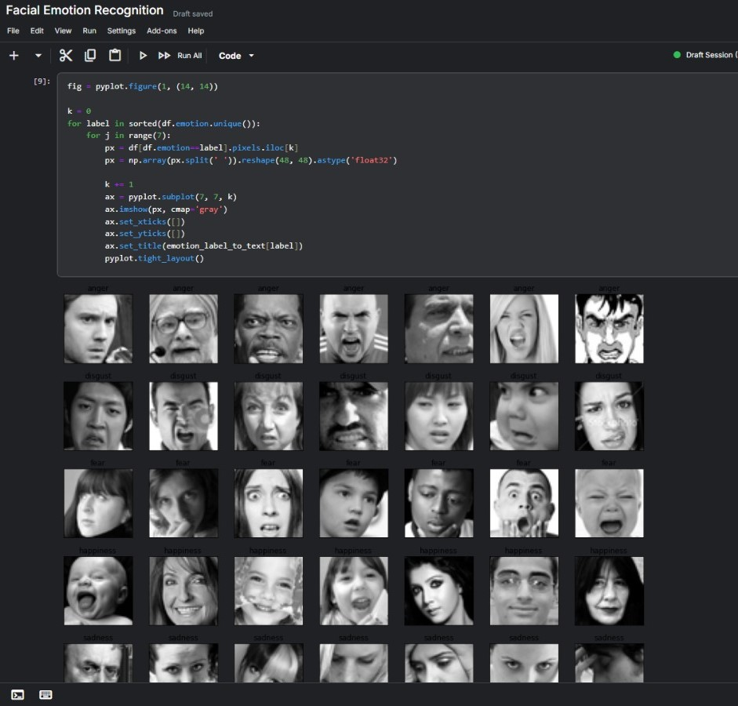
1. Bar graph shows that the majority of emotions like happy, sad, and neutral.
2. Images from the dataset are shown

Slide 10
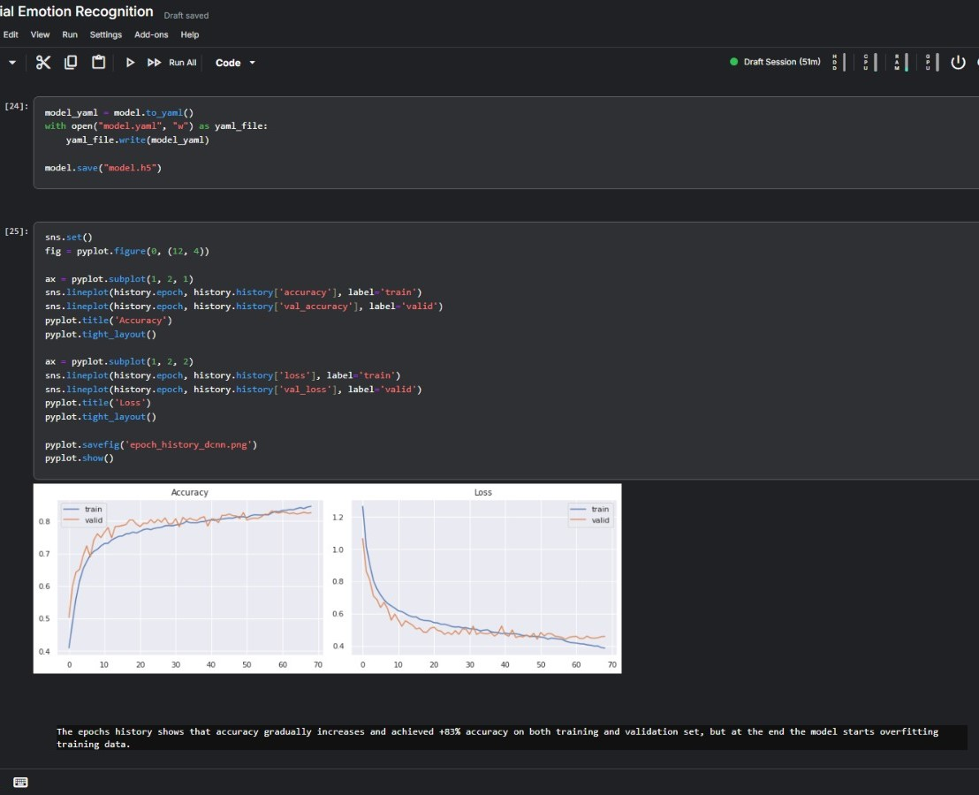
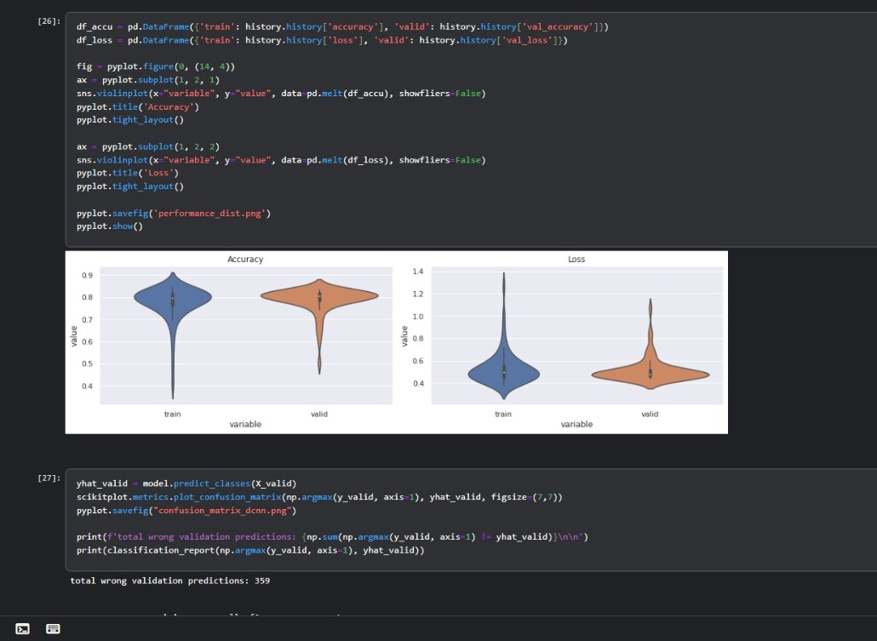
3. graph shows performance of training and validation sets
4. violin plot showing performance of training and validation sets

Slide 11
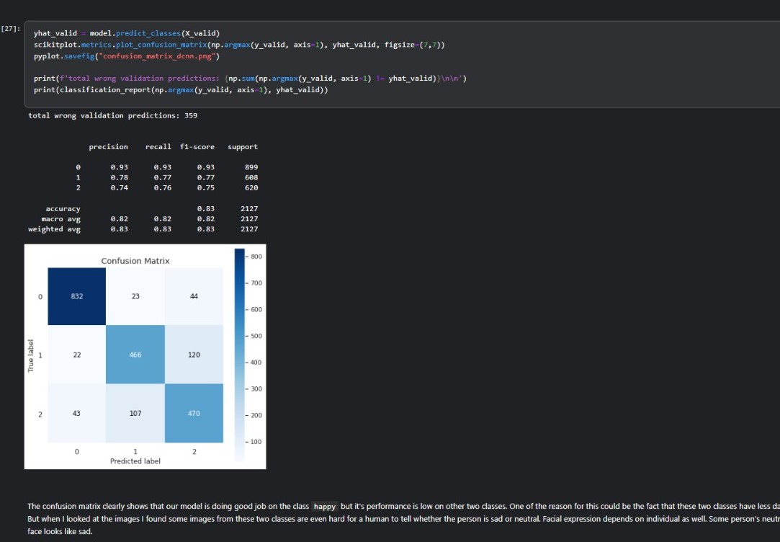
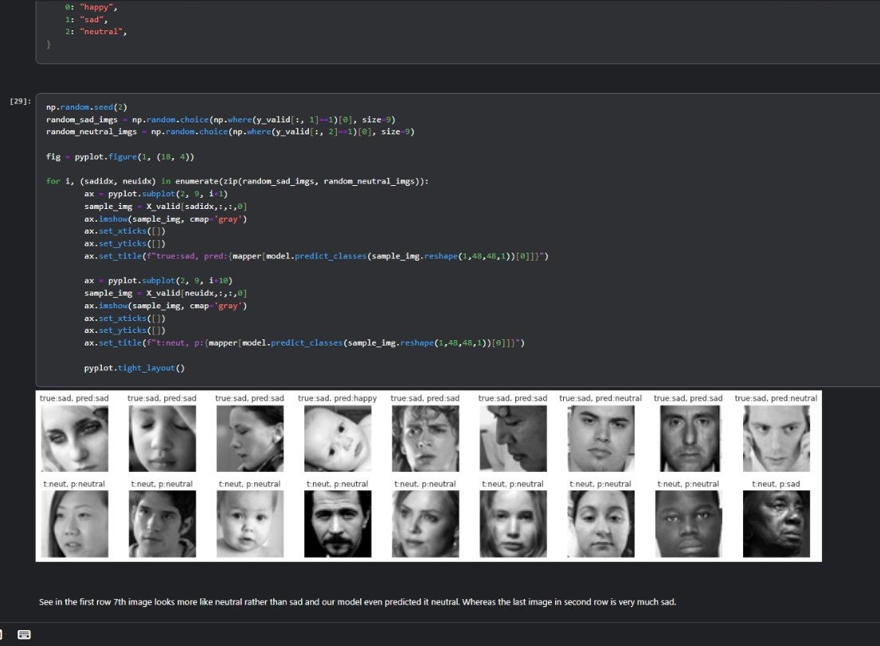
5. confusion matrix showing model performance
6. final output with actual and predicted values

Slide 12
CONCLUSION:
The multimodal human emotion detection system successfully integrates facial expressions and textual sentiment to accurately assess emotional states. By leveraging advanced deep learning models for each modality, the project addresses key challenges such as cultural sensitivity and contextual variability. The user-friendly web application enables real-time emotion analysis, making it valuable in fields like mental health and customer service.
FUTURE SCOPE:
Future enhancements could include using larger and more diverse datasets to improve accuracy and incorporating real-time feedback for continuous learning. Exploring techniques like attention mechanisms and transfer learning could further boost performance. Additionally, expanding the application to support multiple languages and cultural contexts, while prioritizing ethical considerations and user privacy, will be essential for broader adoption and effectiveness.

Slide 13


